Slide 1
Cloud 2021
Researching planning

Slide 2
plan
the first characterization of cloud in reunion
Cor vs lacy @Campus
Cfc cm_saf
Nms/dms
Cloud vs radiation:
Radiation classification

Slide 3
Available cloud data
Cloud classification:
ICARE: 2017-8 to present:

Slide 4
OBS | start | end | classification | temp_reso | spa_reso | AREA | vars | data source | note
icare | 2017-08-01 | present | cloud_type cloud_top | 15 min | 0.05 deg. |  | cloud_type, etc
modis_terra | 2000-01-01 | present | cloud_top | <= 5 min | 1km |  | CWP, COD, CER
modis_aqua | 2002-01-01 | present | cloud_top | <= 5 min | 1km
CALIPSO
CERES |  |  |  |  |  |  |  |  | https://ceres.larc.nasa.gov/data/#syn1deg-level-3
cmsaf CLARA-A (operational) | ? | nearly present | cloud phase, cloud top | Instantaneous | 0.05 deg |  | cloud_phase, cloud top parameters, etc | AVHRR on NOAA | doc. & validation: https://wui.cmsaf.eu/safira/action/viewProduktDetails?eid=22161&fid=32
SARAH | 1983-01-01 | 2017-12-31 | CAL - Effective cloud albedo | Instantaneous | 0.05 deg | MSG full disk at corner |  | MVIRI/SEVIRI on METEOSAT | validated
CLARA | 1982-01-01 | 2019-06-30 | CFC - Fractional cloud cover | daily | 0.25 | Global |  | AVHRR on polar orbiting satellites | validated
COMET ed. 1.0 | 1991-01-01 | 2015-12-01 | CFC - Fractional cloud cover | hourly | 0.05 deg | MSG full disk at corner |  | MVIRI/SEVIRI on METEOSAT | Validation Report
CLAAS ed. 2.0 | 2004-02-01 | 2015-12-01 | CFC - Fractional cloud cover | Monthly mean diurnal-cycle | 0.25 | MSG full disk |  | SEVIRI on MSG | Validation Report

Slide 5
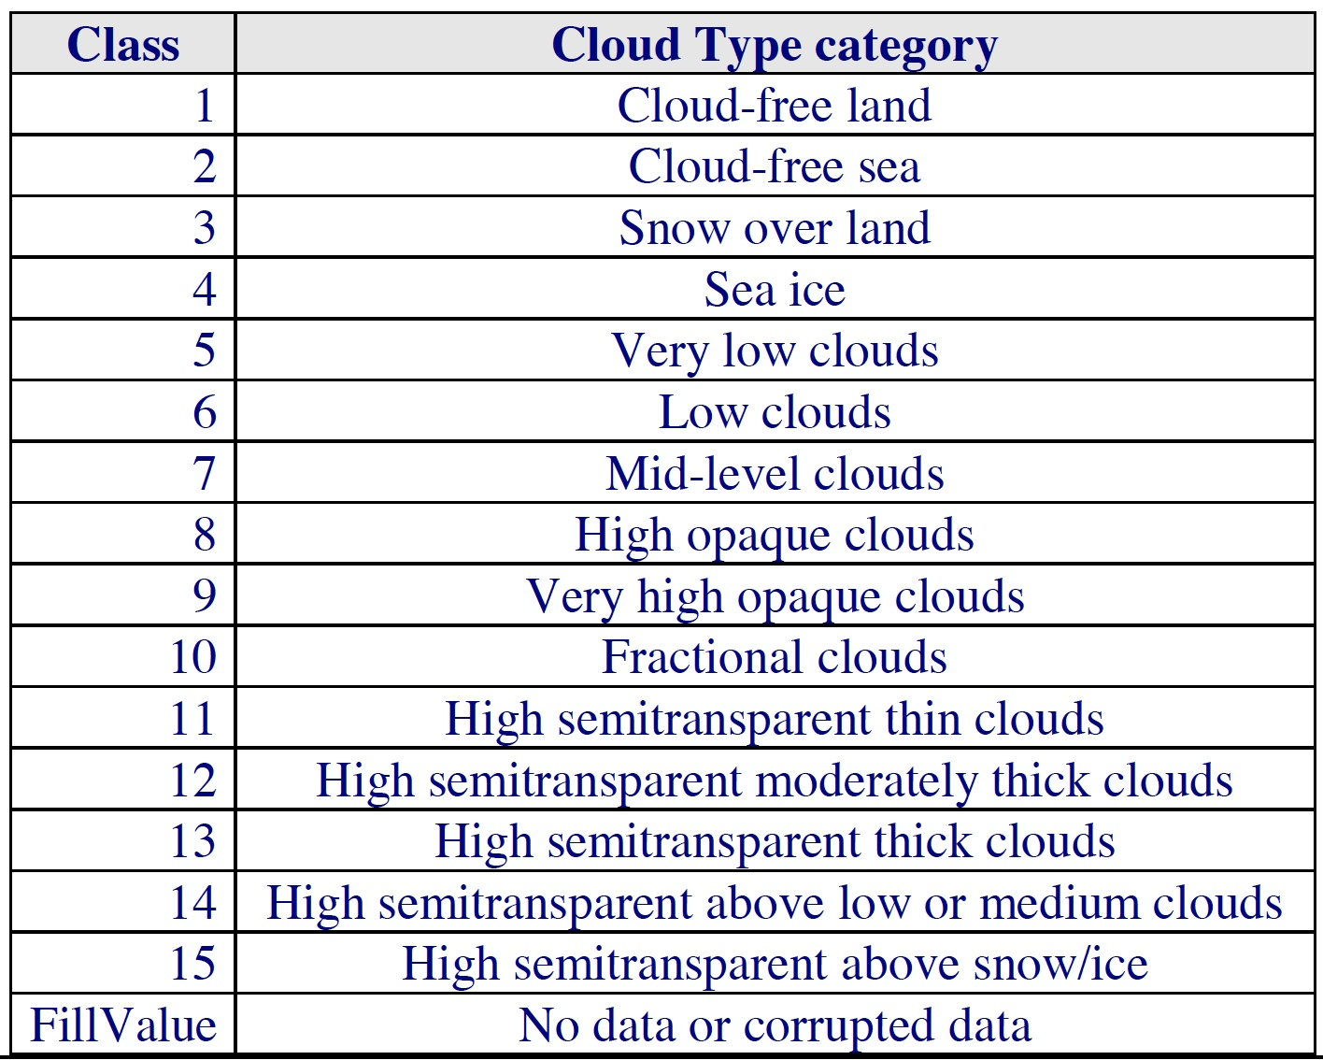
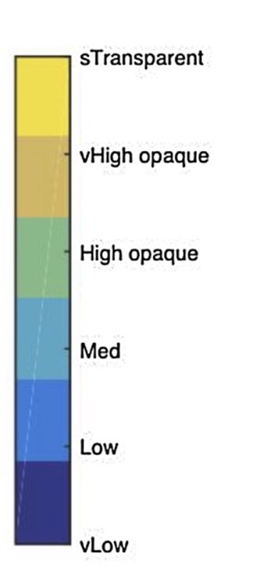
NWC_SAF GEO-CT product: cloud type

Slide 6
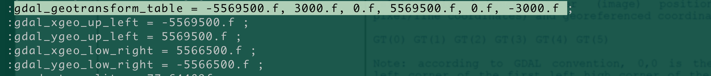
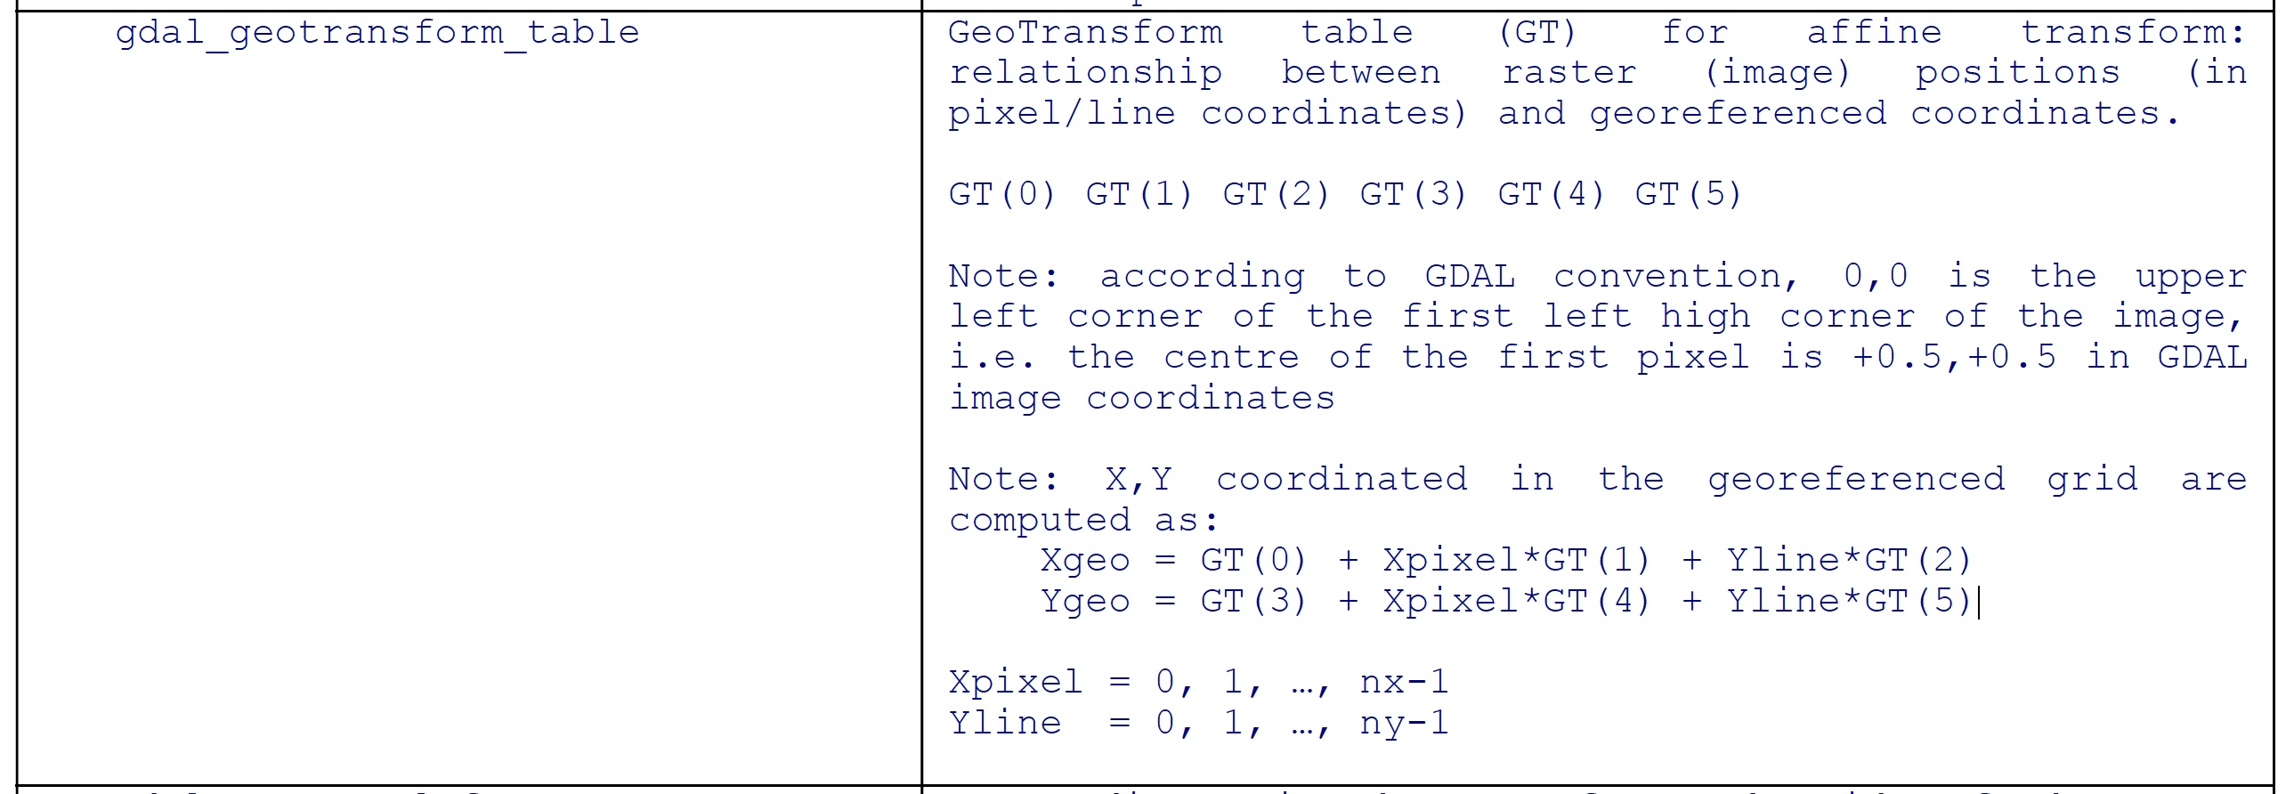
NWC_SAF GEO-CT product: cloud type

Slide 7
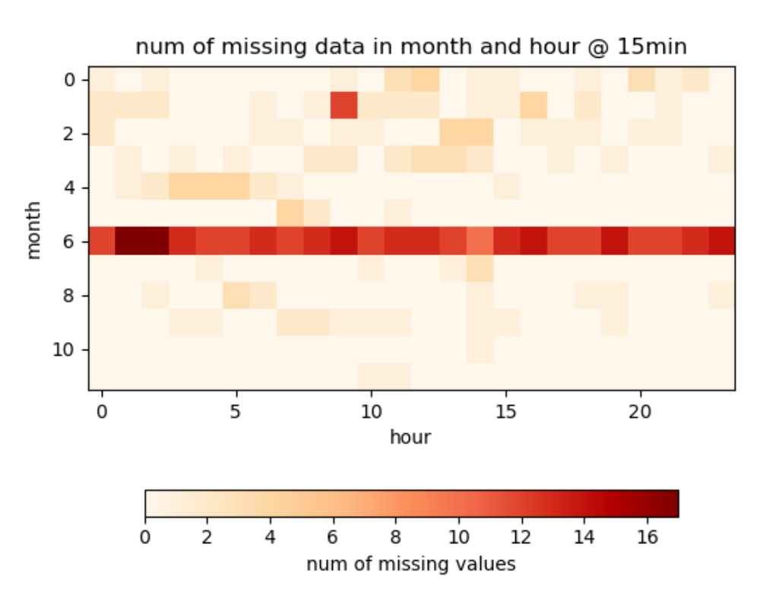
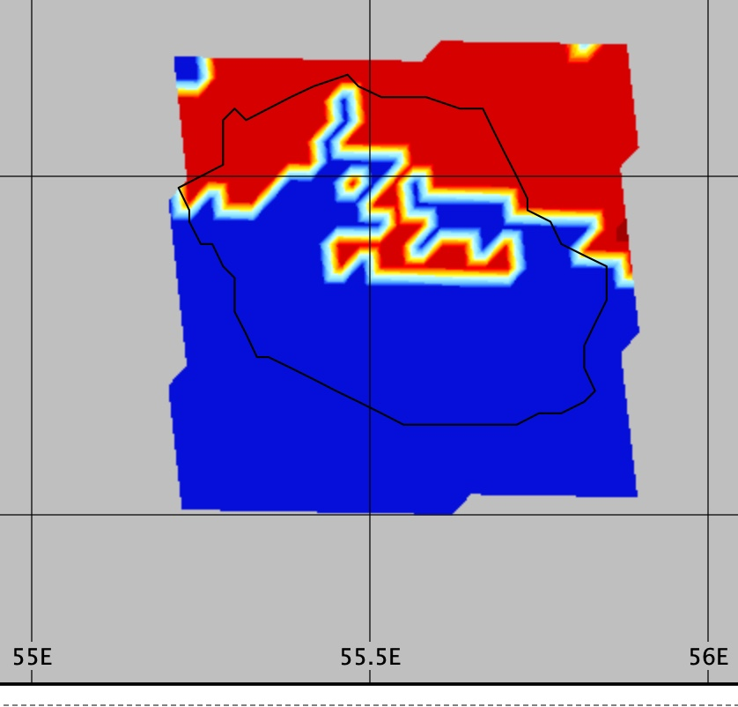
NWC_SAF GEO-CT product: cloud type
Missing data: checked by the reu domain.
Max –> 17/(120 =30days * 4/hour) = 15%
July: ~ 10% missing.
there are 461 missing values ()

Slide 8
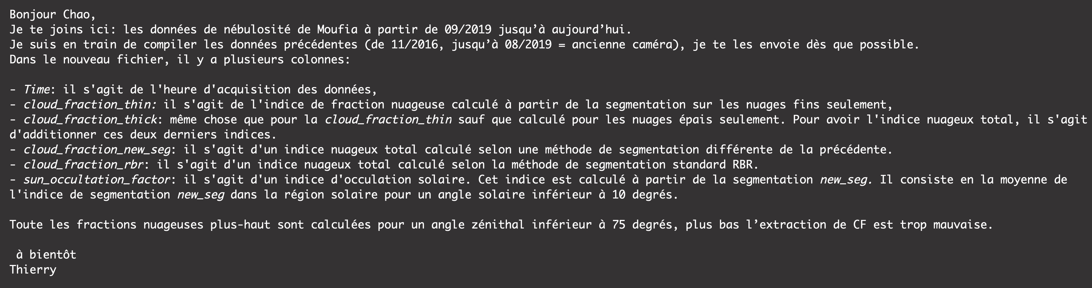
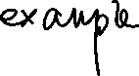






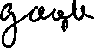




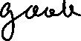
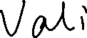
LACy-CF
New camera: 2019-09-13 to 2021-02-01
Old camera: 2016-12-08 to 2019-09-13

Slide 9
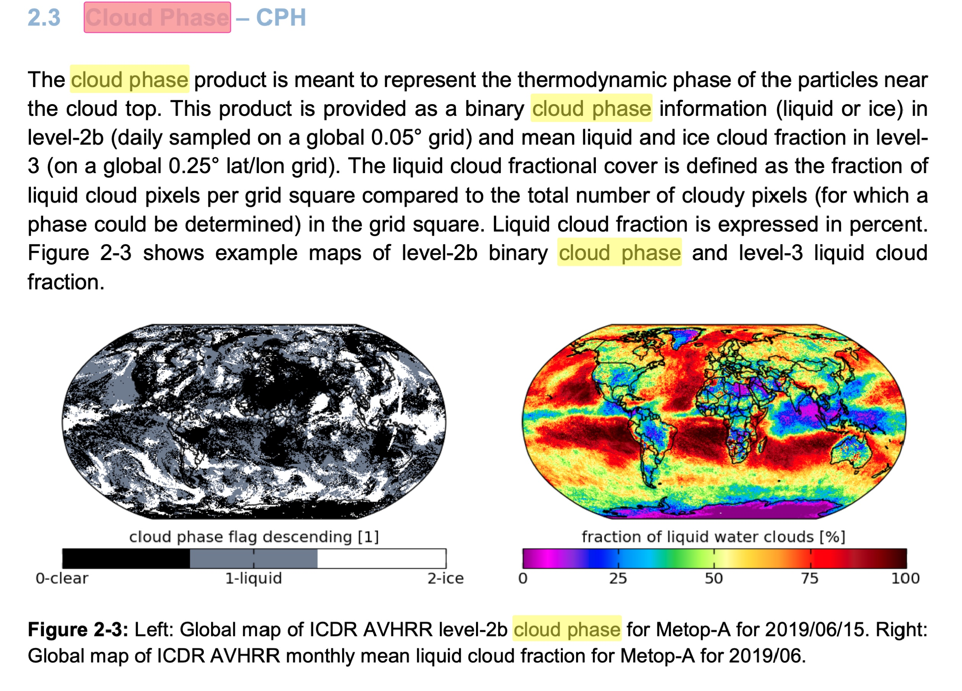
Notes
Cm_saf doc.

Slide 10
iCare data process - download

Slide 11
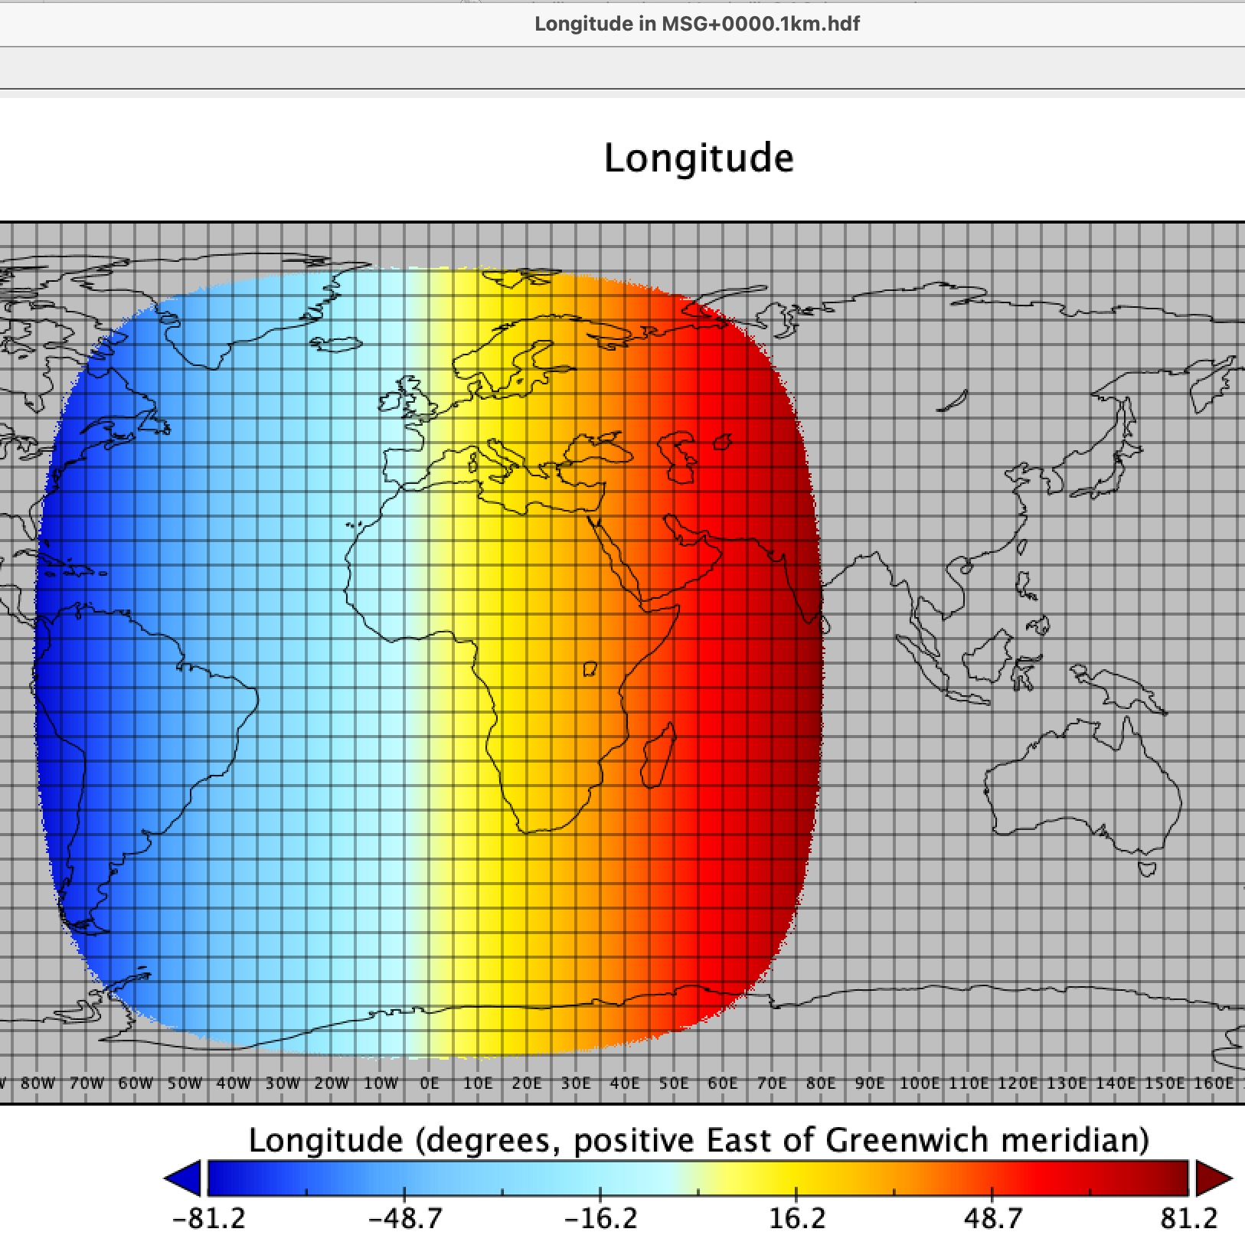
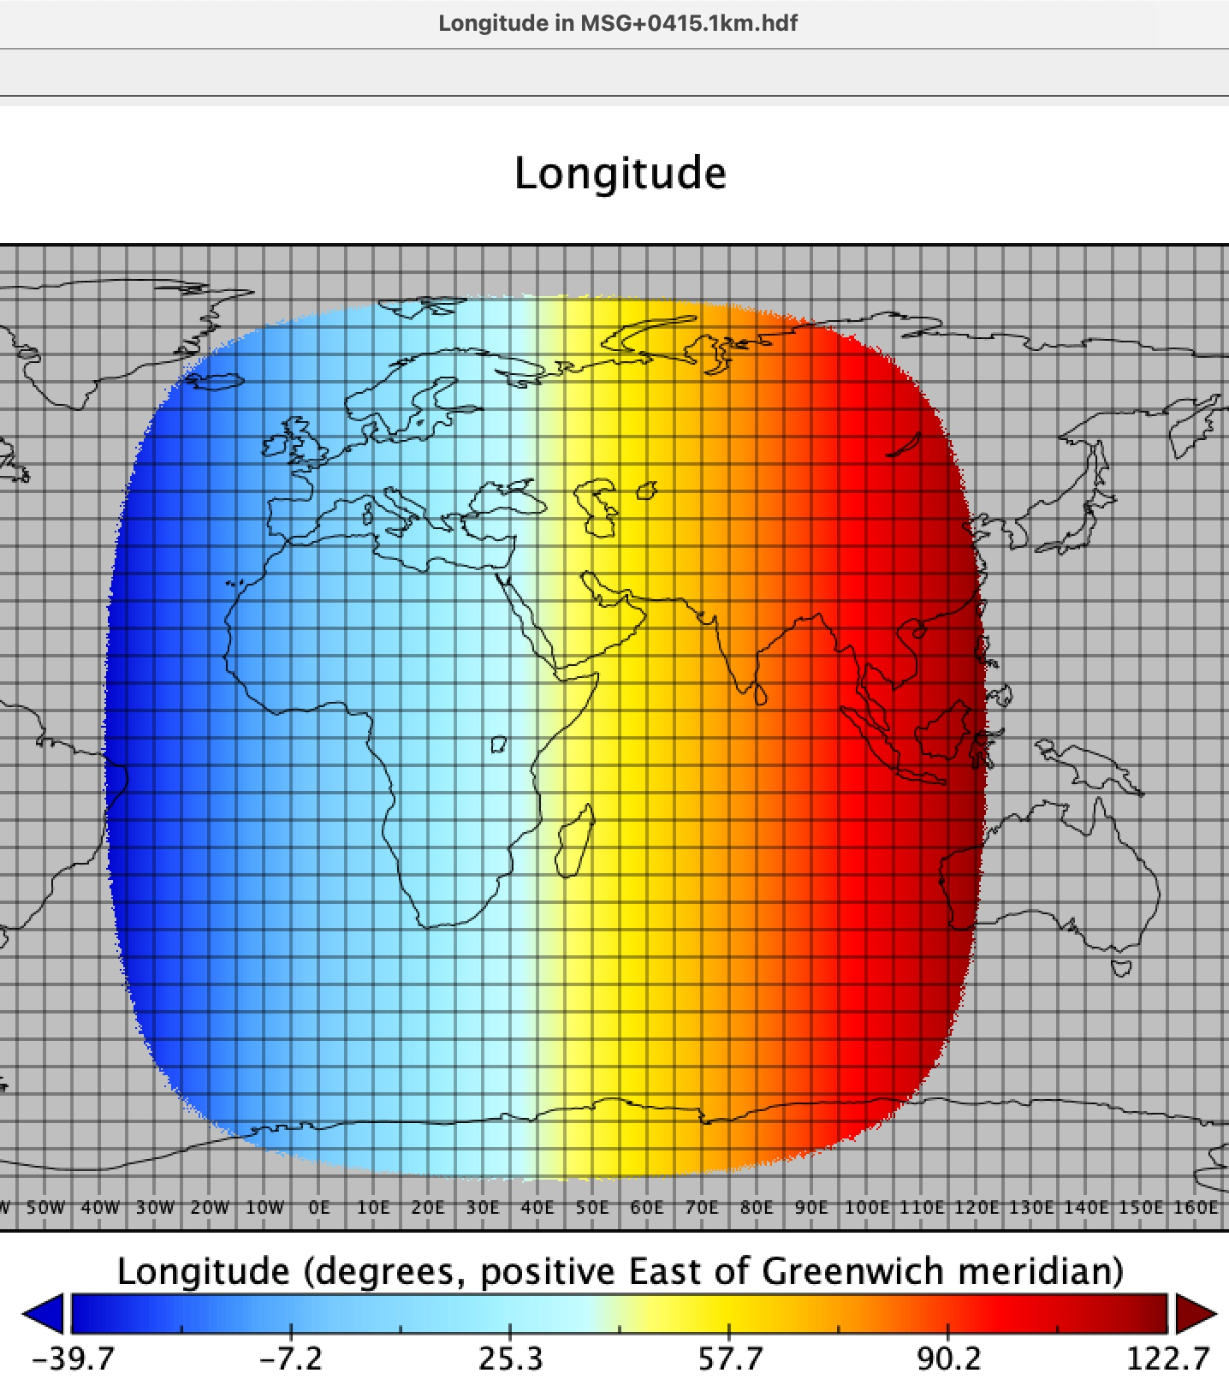
iCare data process - download

Slide 12
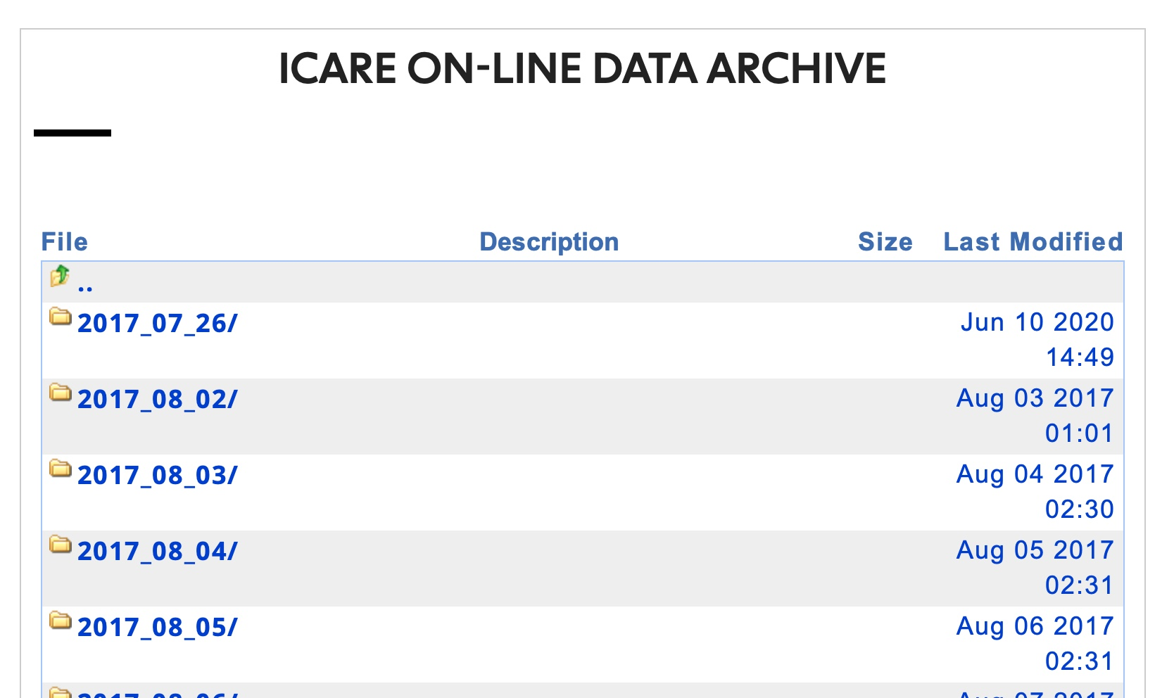
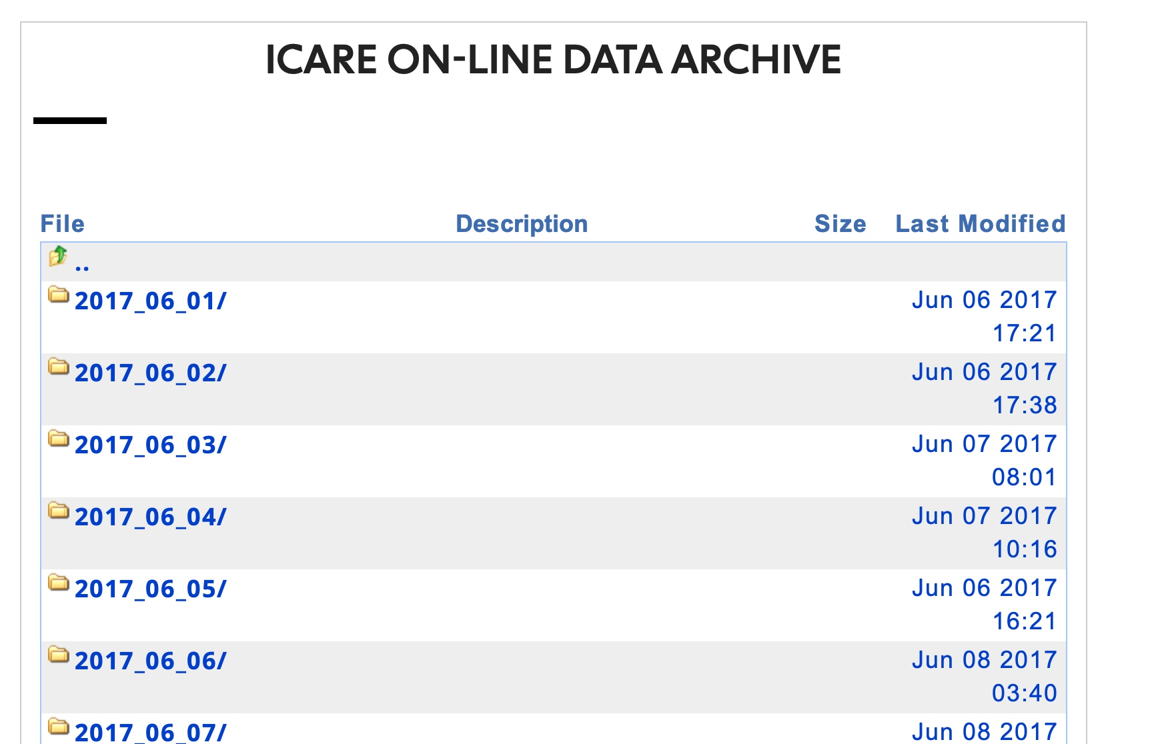
iCare data process
0000 projection (left) or 0415 projection (right) --- similar starting time

Slide 13
iCare data process - download
Similar resolution: 1km and 3km

Slide 14
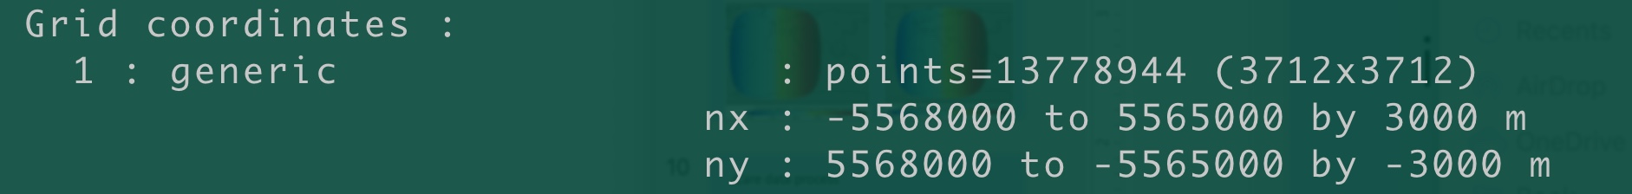
iCare data process - download
Size and file name:
MSG3 is the MSG0000
MSG1 is the MSG0415

Slide 15
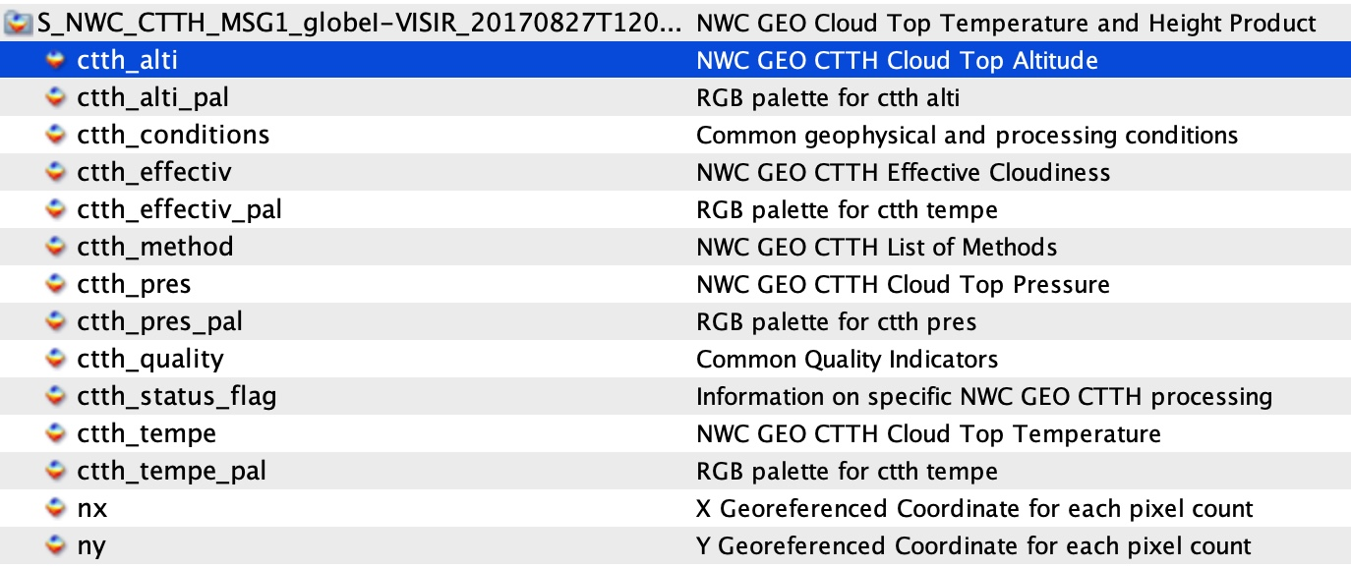
iCare data process - download

Slide 16
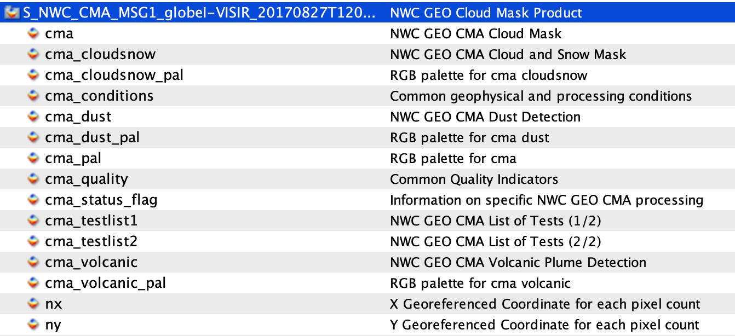
iCare data process - download

Slide 17
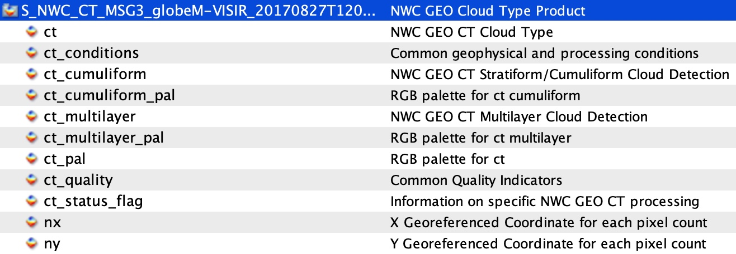
iCare data process - download

Slide 18
iCare data process - download
Difficulty:
3 files @15-min @3km (CT, CMA, CTTH) over swio (sellonlatbox,-2,112,12,-52) takes 720 T
No idea to download 1km data

Slide 19
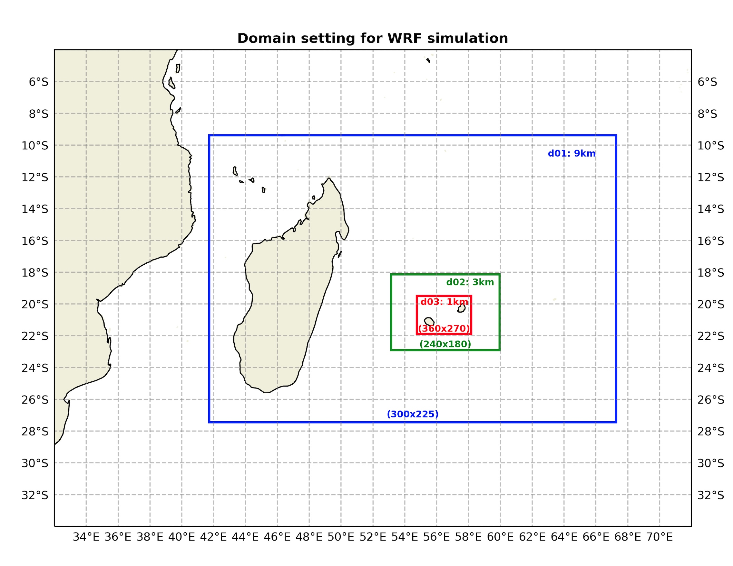
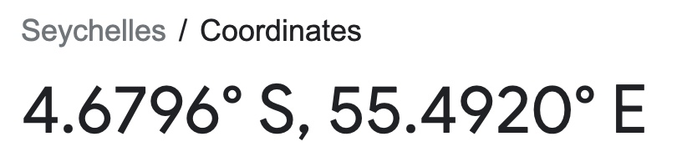
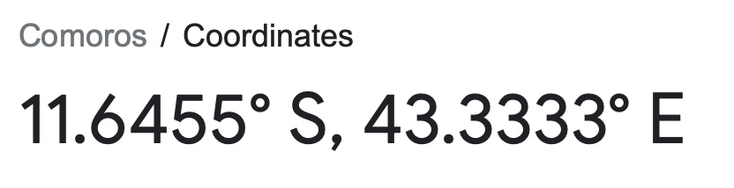
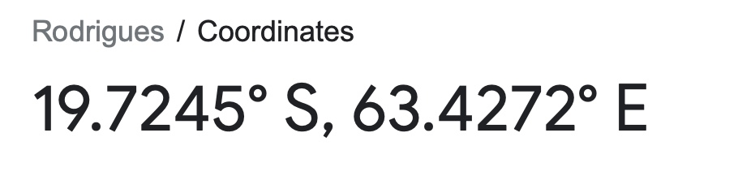
iCare data process - download
Solution:
3 files @15-minute @3-km (CT, CMA, CTTH) over swio (sellonlatbox,-2,112,12,-52) takes 720 T – download only 1-hourly CT data over the blue one 42,65,-28,-10, save to (18*23)/(114*64)*720/3/4= 3.40460526 Tb
NOT included
included
included

Slide 20
iCare data process - download
Solution:
No idea to download 1km data – Write to iCARE (GSM+0415)

Slide 21
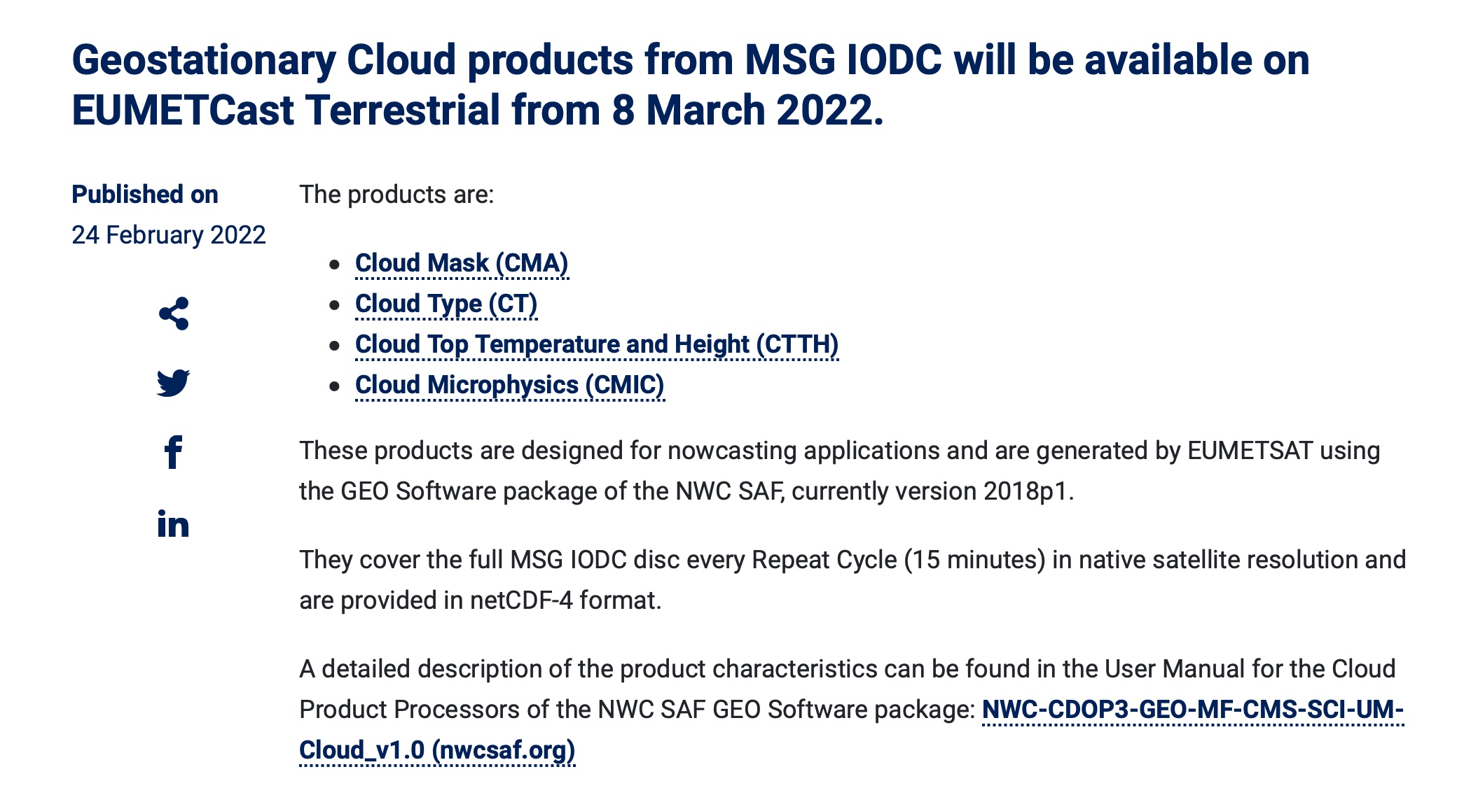
News:

